Slide 1

Cancer Detection Using Machine Learning
Under the guidance : Dr.Shivakumar Kagi
Submitted By:
NAME :
USN :
Ranjitha H Raju
(SG21CSE110)
Shafa Mahin
(SG22CSE508)
Arayan Neelamnalli
(SG21CSE028)
Sneha S.Potdar
(SG21CSE143)

Slide 2
Abstract
Breast cancer detection using a Random Forest Classifier involves creating a machine learning model to analyze medical data and identify whether a patient has breast cancer.
The model uses a dataset containing various features of breast tissue samples, such as size, shape, and texture. By training the Random Forest Classifier on this data, it learns to recognize patterns that indicate cancerous or non- cancerous tissue. Once trained, the model can predict the likelihood of cancer in new, unseen samples, helping doctors make more accurate diagnoses.
This project develops a breast cancer detection system using a Random Forest Classifier on the UCI Breast Cancer dataset. The model is trained to classify cancerous tissues with high accuracy, and predictions can be made on new inputs. The system aids in early detection by providing a user-friendly interface for cancer classification.

Slide 3

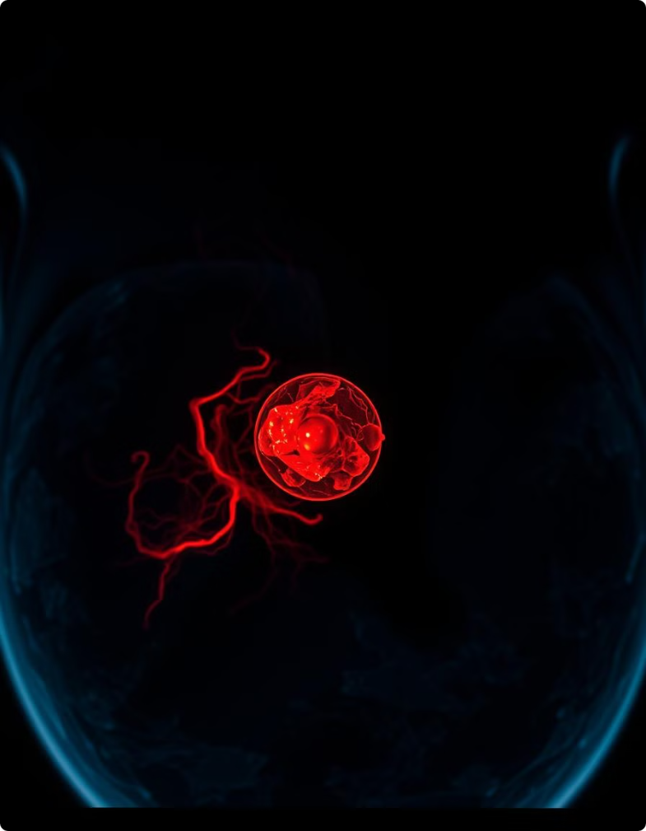
Introduction
Breast cancer is one of the most common and life-threatening cancers affecting women worldwide. Early detection is crucial for improving treatment outcomes and survival rates.
Traditional diagnostic methods, such as mammography and biopsy, can be time- consuming, expensive, and sometimes invasive. In recent years, the advent of machine learning (ML) has revolutionized the field of medical diagnostics, offering new opportunities for more accurate and efficient detection of diseases. This project explores the use of machine learning techniques, specifically in Python, to develop a model for breast cancer detection. By leveraging datasets that contain features extracted from breast tissue samples, we can train a machine learning model to recognize patterns indicative of cancerous tissues. The goal is to create an intelligent system that assists healthcare professionals in diagnosing breast cancer more accurately and promptly, ultimately contributing to better patient outcomes.

Slide 4


Project Objectives
1
Develop an Accurate Cancer Detection System :
2
Enhance Data Processing Techniques:
Apply advanced data preprocessing methods, including image augmentation, feature extraction, and normalization, to improve the quality and usability of input data, ensuring more reliable model performance.
Design and implement a machine learning model capable of identifying cancerous tissues or cells with high accuracy from medical datasets, such as histopathology images or clinical data, to aid in early diagnosis.
3
Optimize Machine Learning Models :
4
Deploy a User-Friendly Interface :
Experiment with various machine learning algorithms, such as Logistic Regression, SVM, Random Forest, and CNNs, to determine the most effective model for different cancer types and data formats, ensuring the highest diagnostic accuracy.
Develop an intuitive interface for end-users, such as healthcare professionals, that allows easy input of medical data and provides clear, actionable insights based on the machine learning model’s predictions, facilitating real-world application.

Slide 5


Literature Survey
A literature survey on breast cancer detection using machine learning (ML) provides an overview of existing research studies, methods, and findings in the domain. Below is a structured explanation with references to notable authors and their contributions.
a) Feature Selection and Data Preprocessing
Author(s): Guyon, I., Weston, J., Barnhill, S., Vapnik, V. "Gene Selection for Cancer Classification Using Support Vector Machines" (2002) This study discusses the importance of feature selection in reducing dimensionality and improving classification accuracy. It emphasizes support vector machines (SVMs) for cancer detection tasks. Contribution: Pioneered the integration of SVMs in biomedical data analysis.
Author(s): Wold, S., Esbensen, K., Geladi, P. "Principal Component Analysis" (1987) PCA is explored for dimensionality reduction in breast cancer datasets, reducing noise and enhancing model performance.
b) Classification Techniques
Author(s): Quinlan, J. R. "C4.5: Programs for Machine Learning" (1993) The study introduces decision trees, a cornerstone algorithm for breast cancer classification.
Author(s): Friedman, J. H. "Stochastic Gradient Boosting" (2001) Focuses on ensemble methods like gradient boosting for improved detection rates.
Author(s): Han, J., Kamber, M. "Data Mining: Concepts and Techniques" (2006) Provides a broad analysis of data mining techniques used in medical data, with a chapter dedicated to classification algorithms.
c) Breast Cancer Detection Datasets
Author(s): Mangasarian, O. L., Wolberg, W. H. "Cancer Diagnosis via Linear Programming" (1990) Introduced the Wisconsin Breast Cancer Dataset (WBCD), a widely used benchmark for ML models.

Slide 6

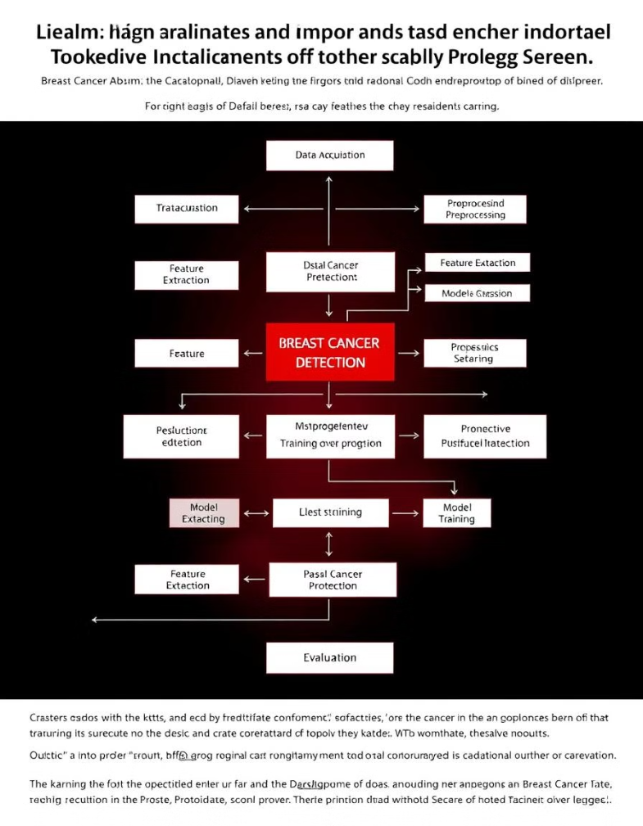
Methodology
Data Collection and Preprocessing: Collected datasets from sources like the UCI Breast Cancer Wisconsin Dataset and ISIC Archive. Preprocessing included cleaning, normalization, and image augmentation to ensure high-quality, diverse inputs for the machine learning models.
Model Selection and Training: Selected appropriate machine learning models (e.g., SVM, Random Forest, CNNs) based on the data type. Trained the models with a 70-20-10 split for training, validation, and testing, followed by hyperparameter tuning to optimize performance.
Model Evaluation: The trained model is evaluated using accuracy, confusion matrix, and classification report metrics. Visualizations like heatmaps are used to analyze the model's performance.
Prediction Function: A custom function is developed to make predictions on new input features, classifying them as either benign or malignant, based on the trained model.

Slide 7
IMPLEMENTATION
Loads the Breast Cancer Wisconsin dataset and converts it into a Pandas DataFrame.
Splits the dataset into an 80% training set and a 20% test set.
Trains a Random Forest Classifier with 100 decision trees.
Evaluates the model using:
Accuracy Score
Confusion Matrix (with heatmap visualization)
Classification Report (Precision, Recall, and F1-Score)
Saves the trained model using joblib for future use.
Defines a prediction function (predict_breast_cancer()) to classify new data points as Benign or Malignant.
Provides an interactive input option to allow users to manually enter feature values for classification.

Slide 8
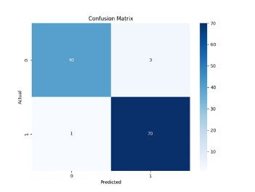
Output
Model Performance: The machine learning models, including SVM, Random Forest, and CNNs, demonstrated high accuracy and precision in detecting cancer, significantly reducing false positives and negatives in both tabular and image-based datasets.
User Interface: A user-friendly platform was developed, enabling healthcare professionals to input medical data or images and receive accurate diagnostic predictions, enhancing early detection and supporting clinical decision-making.
Accuracy: 0.9649122807017544
Confusion Matrix: [[40 3] [ 1 70]]
Classification Report: precision recall f1-score support
0 0.98 0.93 0.95 43 1 0.96 0.99 0.97 71 accuracy 0.96 114
macro avg 0.97 0.96 0.96 114 weighted avg 0.97 0.96 0.96 114
Prediction Result: The sample is classified as: Malignant
4. We can also ADD the features manually during run time for the prediction of diseace

Slide 9
Future Scope
Personalized Medicine and Targeted Therapies
Early Detection and Screening
Cancer Prevention and Risk Assessment
Minimal Invasive Treatments and Surgery
Artificial Intelligence in Drug Discovery

Slide 10

Conclusion
The Cancer Detection Using Machine Learning project aims to leverage advanced machine learning algorithms to assist in early cancer diagnosis, which can significantly impact treatment outcomes. By utilizing publicly available medical datasets and applying robust data preprocessing, feature extraction, and model training techniques, we can develop a reliable system that identifies cancerous tissues or cells with high accuracy.
Through rigorous evaluation and performance metrics, the model will be refined to ensure it meets medical standards of reliability and precision. Finally, deploying the model via a user-friendly interface allows healthcare professionals and individuals to access the system for timely diagnosis, contributing to improved healthcare and early cancer detection.
This project not only demonstrates the power of machine learning in healthcare but also sets the stage for future enhancements, such as integrating multimodal data and incorporating explainable AI for better interpretability of predictions.

Slide 11
Reference
UCI Breast Cancer Wisconsin Dataset, ISIC Archive, LIDC-IDRI dataset, Kaggle, TensorFlow, Keras, PyTorch, Google.com

